Slide 1
Solutions for Homework1
ECE3056
Moinuddin K Qureshi

Slide 2
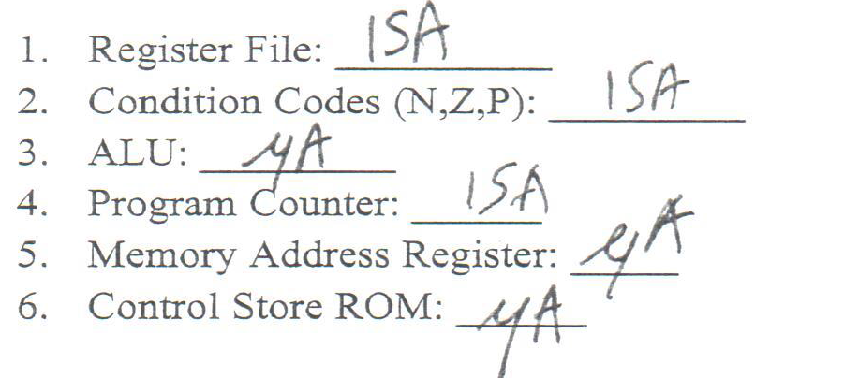
Q1. Part a

Slide 3
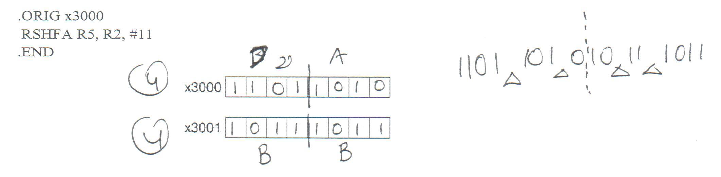
Q1. Part b

Slide 4
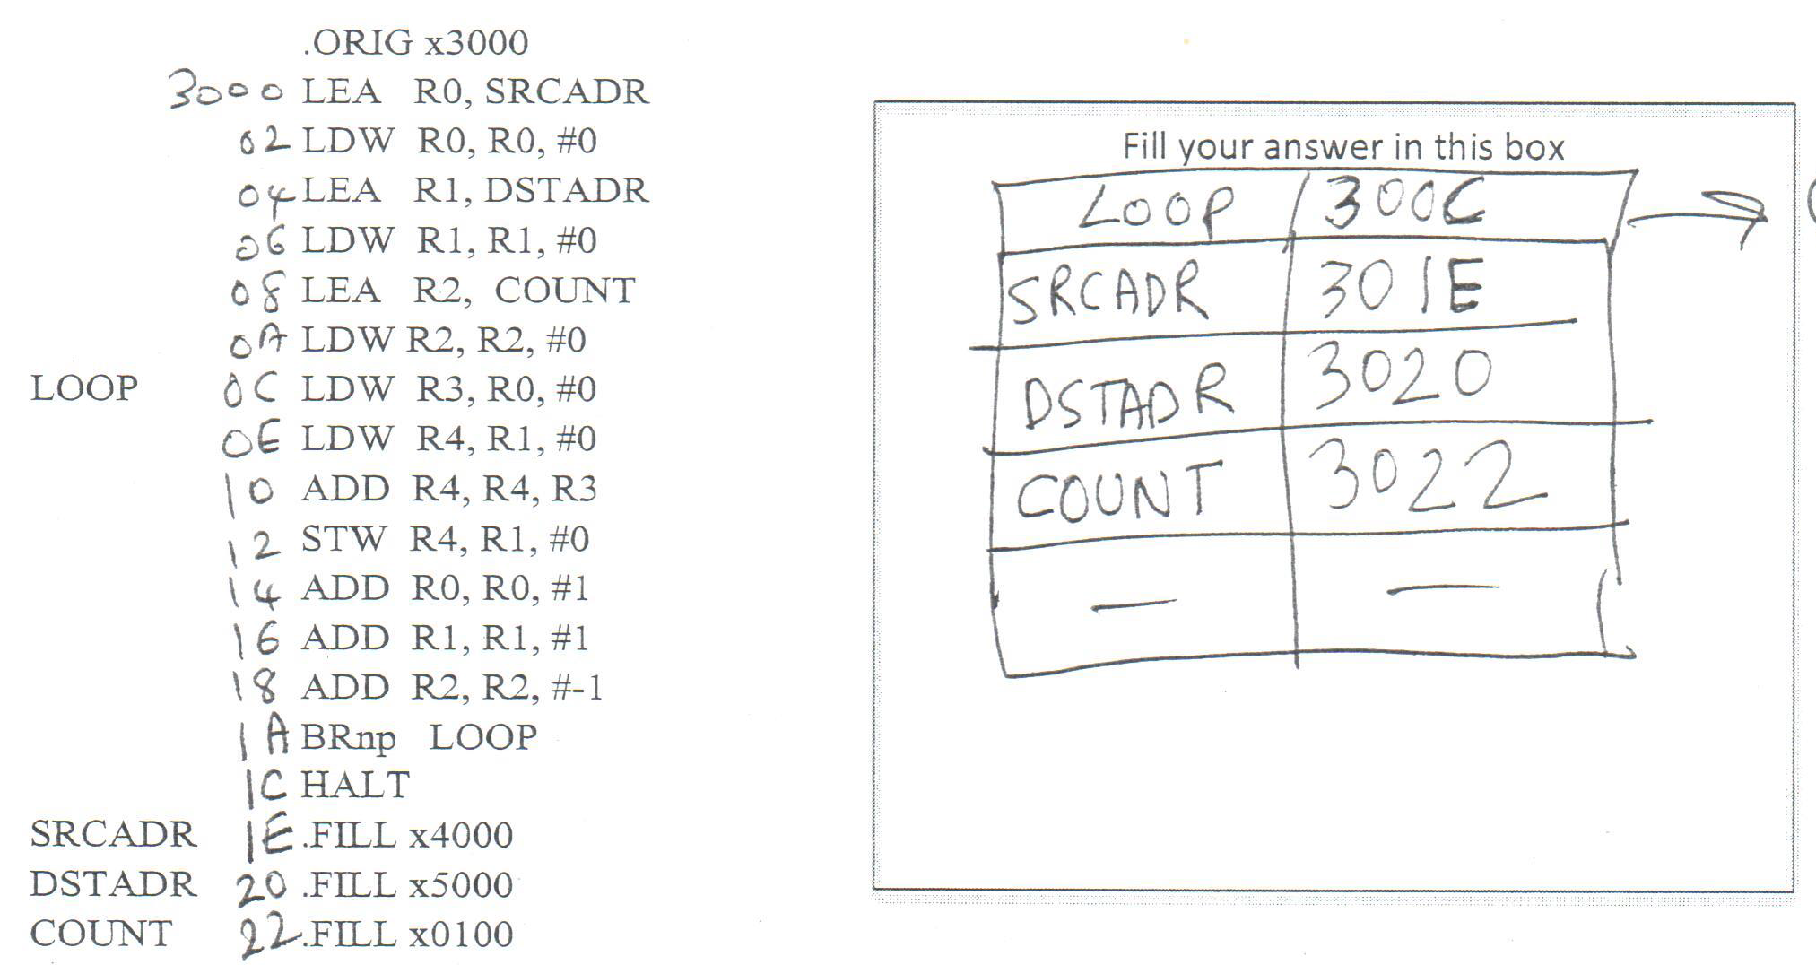
Q1. Part c (Symbol Table)

Slide 5
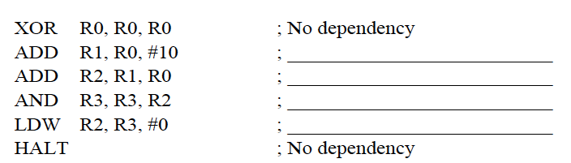
Q1. Part d
RAW with Inst1
RAW with Inst1 and Inst2
RAW with Inst3
RAW with Inst4, WAW with Inst3

Slide 6
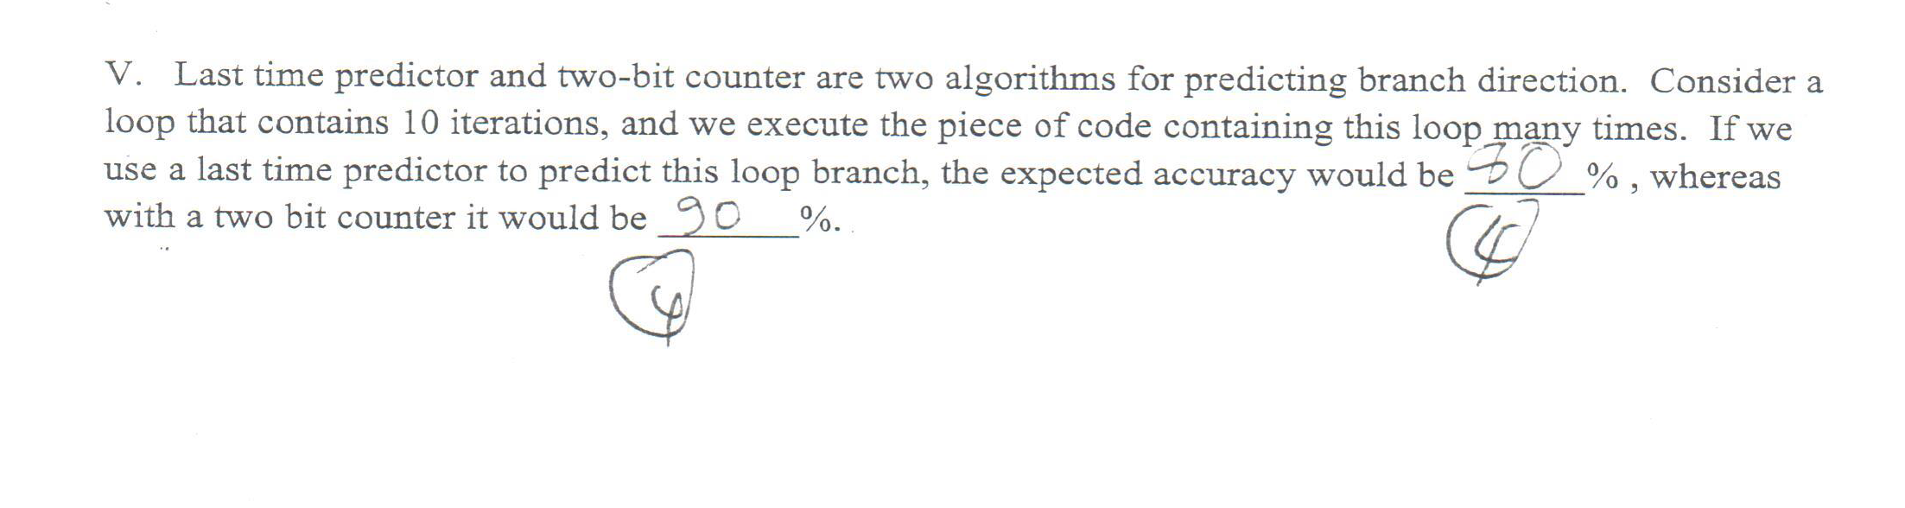
Q1. Part e

Slide 7
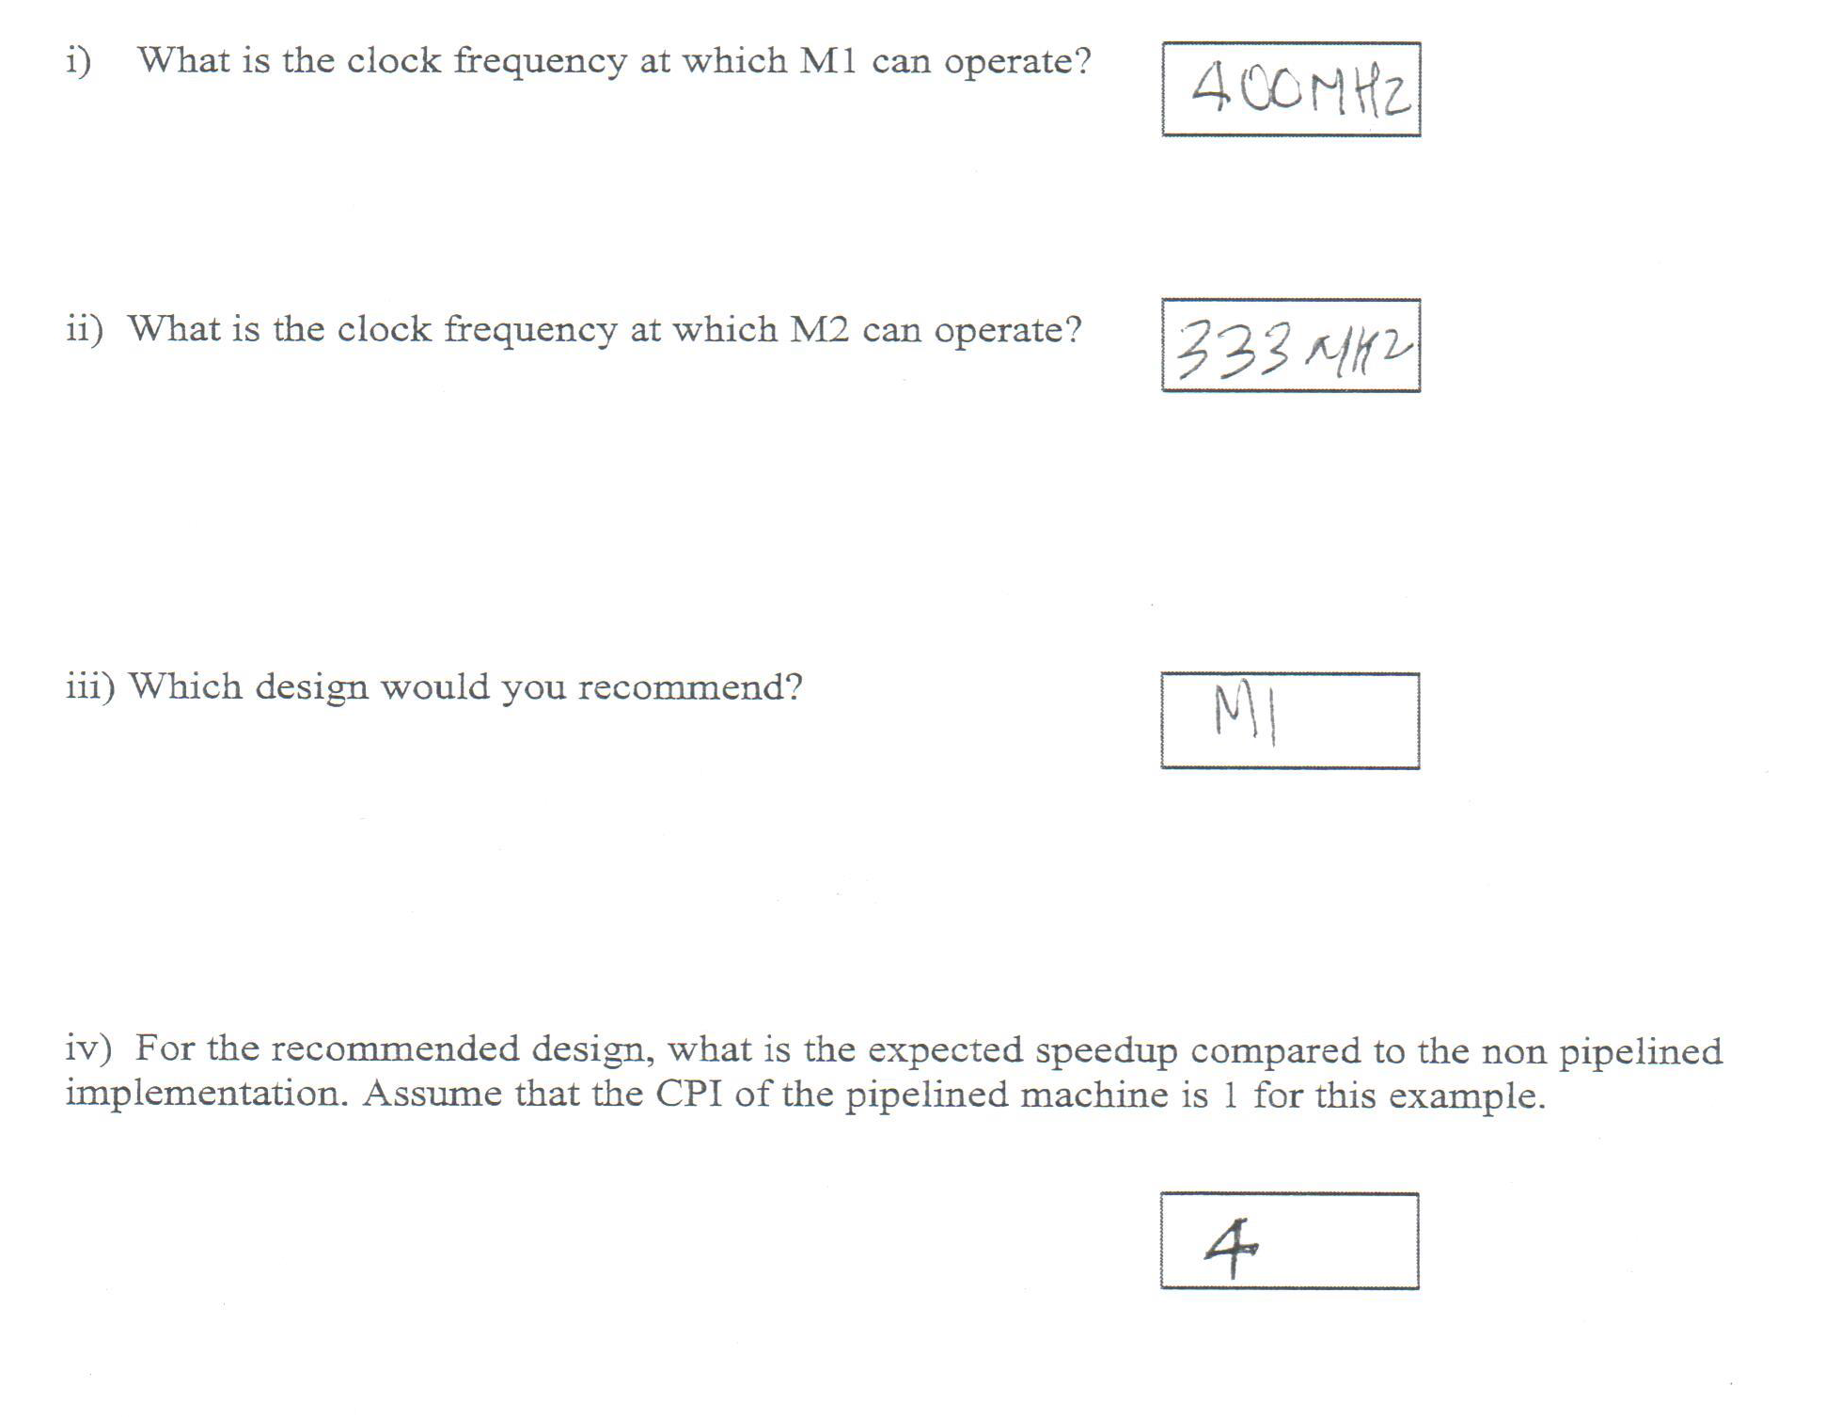
Q2

Slide 8
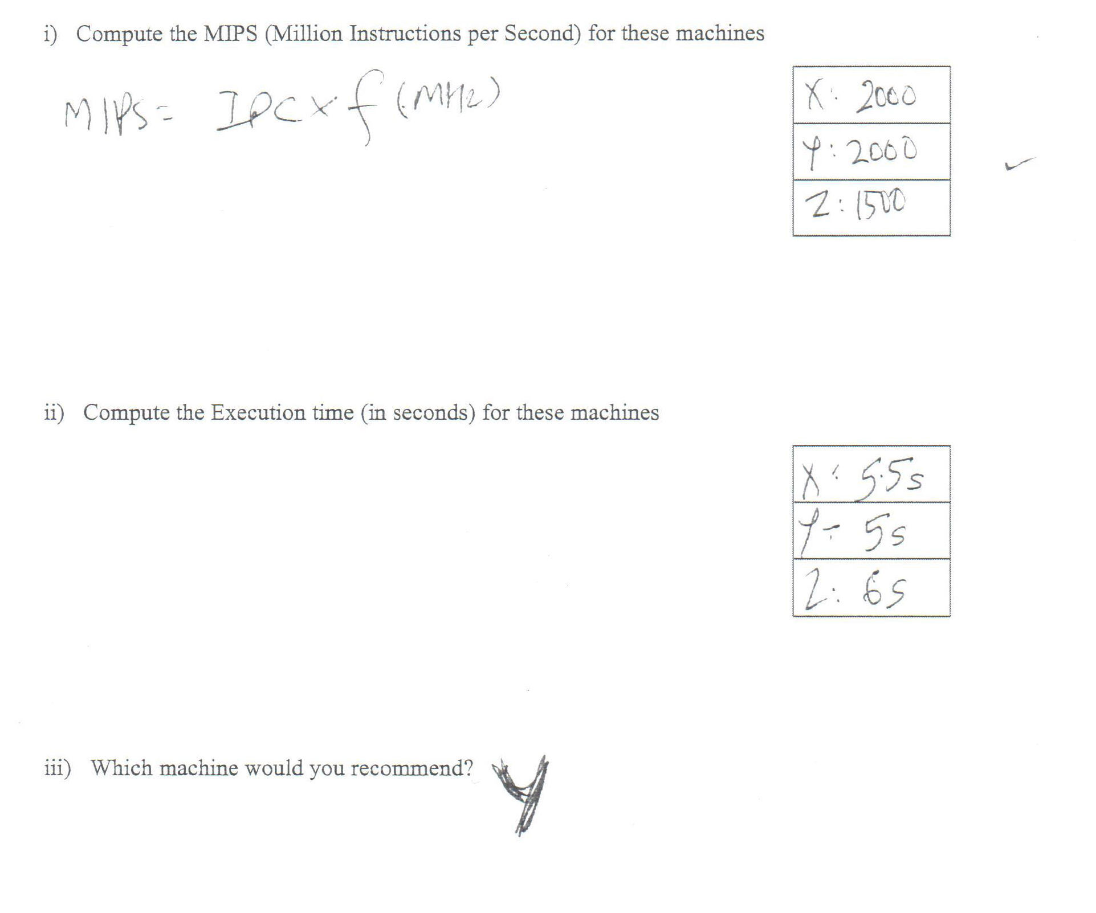
Q3

Slide 9
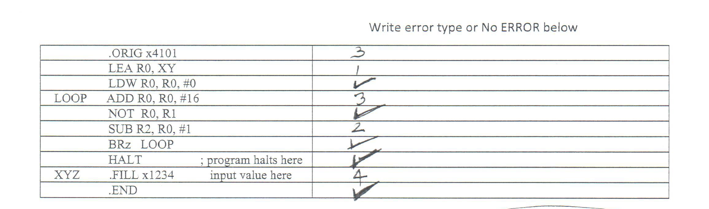
Q4

Slide 10
Q5
KEY IDEA: OR can be implemented as follows
OR(A,B) = NOT( NOT(A) . NOT(B) )
Steps:
SR1 ⬅ NOT SR1
SR2 ⬅ NOT SR2
DR = SR1 AND SR2
SR1 ⬅ NOT SR1
SR2 ⬅ NOT SR2
DR ⬅ NOT DR (set CC here)
NOTE:
You can do NOT by using the XOR function in ALU and using 0xFF as SR2Op
You should leave SR1 and SR2 unchanged (the contract of ISA)
3. For this problem only, you can assume that SR1, SR2, and DR are different registers

Slide 11
Q5 (a)
10
SR1 ⬅ NOT SR1
LMUX=1, ALUK=XOR, LDREG, DR=SR1
50
SR2 ⬅ NOT SR2
LMUX=1, ALUK=XOR, LDREG, DR=SR2
SR1 should come from SR2 bits in IR
51
DR ⬅ SR1 AND SR2
LMUX=0, ALUK=AND, LDREG, DR=DR
52
SR1 ⬅ NOT SR1
LMUX=1, ALUK=XOR, LDREG, DR=SR1
53
SR2 ⬅ NOT SR2
LMUX=1, ALUK=XOR, LDREG, DR=SR2
SR1 should come from SR2 bits in IR
54
DR ⬅ NOT DR
setCC()
LMUX=1, ALUK=XOR, LDREG, DR=DR
SR1 should come from DR bits in IR
Set CC
18

Slide 12
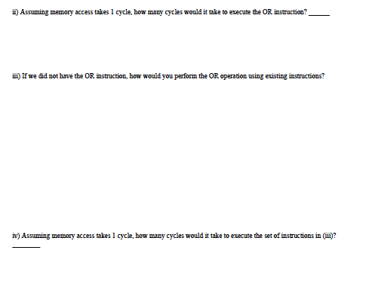
Q5 (b, c)
4 till decode + 6 for execute = 10 cycles
NOT SR1, SR1
NOT SR2, SR2
AND DR, SR1, SR2
NOT SR1, SR1 ; cleanup for SR1
NOT S2, SR2 ; cleanup for SR2
NOT DR, DR ; to get right answer, and set CC
So, a total of six instructions (or four instructions without cleanup)

Slide 13
Q5 (d)
(iv) Assuming memory accesses take 1 cycle, how many cycles will it take to execute the code in part (iii)
We need to do NOT A, NOT B, AND, and NOT DR
So at least four instructions (without cleanup of A,B)
Or six instructions with cleanup of A and B
Each instruction takes 5 cycles (4 till decode + 1 execute)
Total cycles = 20 (without cleanup) or 30 (with cleanup)
Thus , the hardware implementation is 2x to 3x faster

Slide 14
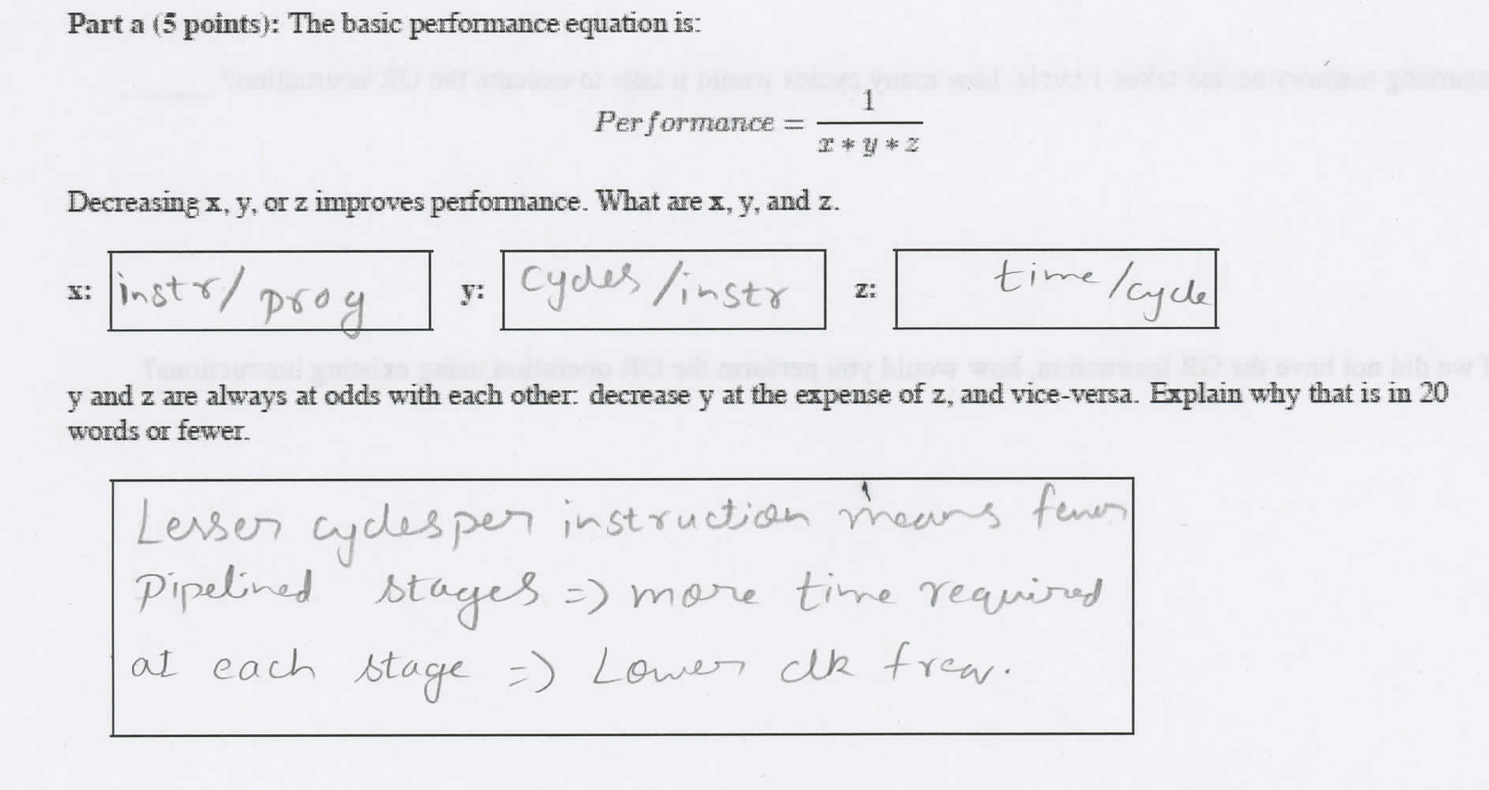
Q6(a)

Slide 15
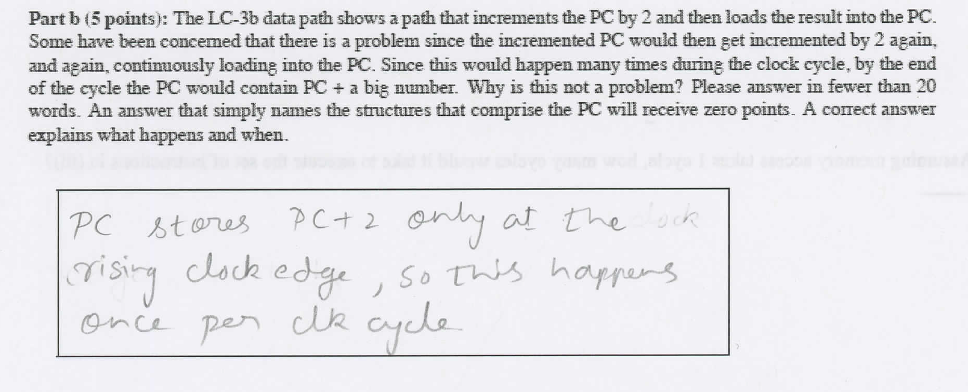
Q6(b)

Slide 16
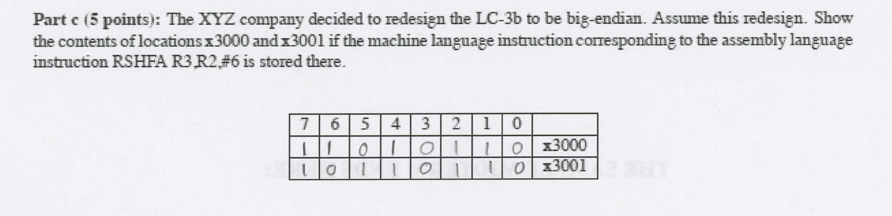
Q6(c)

Slide 17
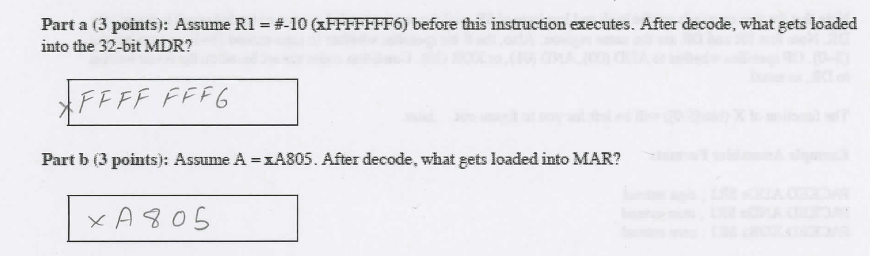
Q7(a,b)

Slide 18
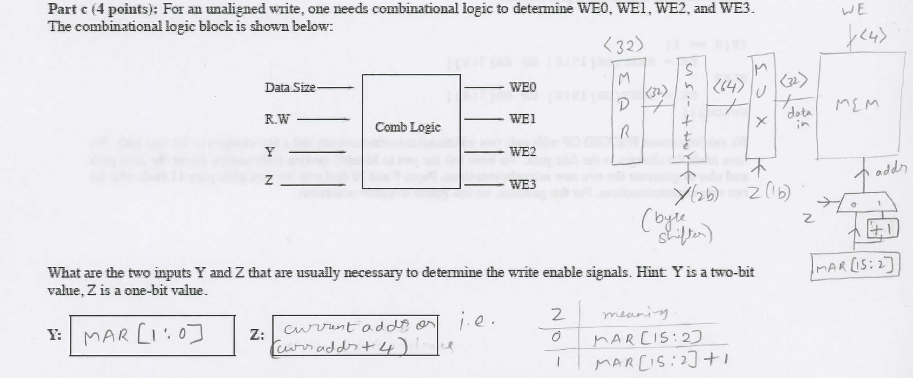
Q7(c)

Slide 19
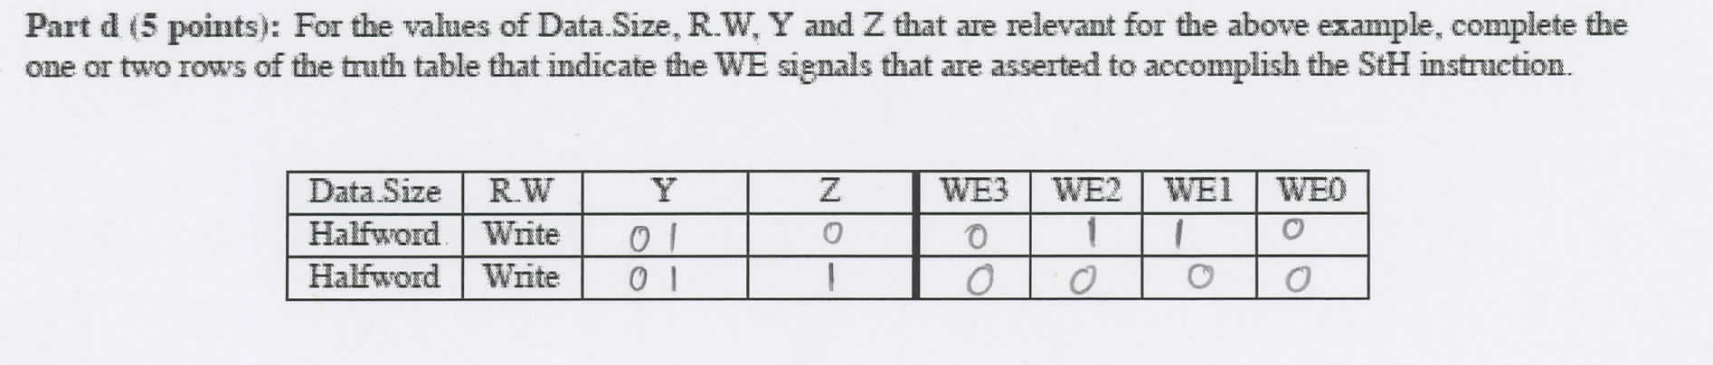
Q7(d)

Slide 20
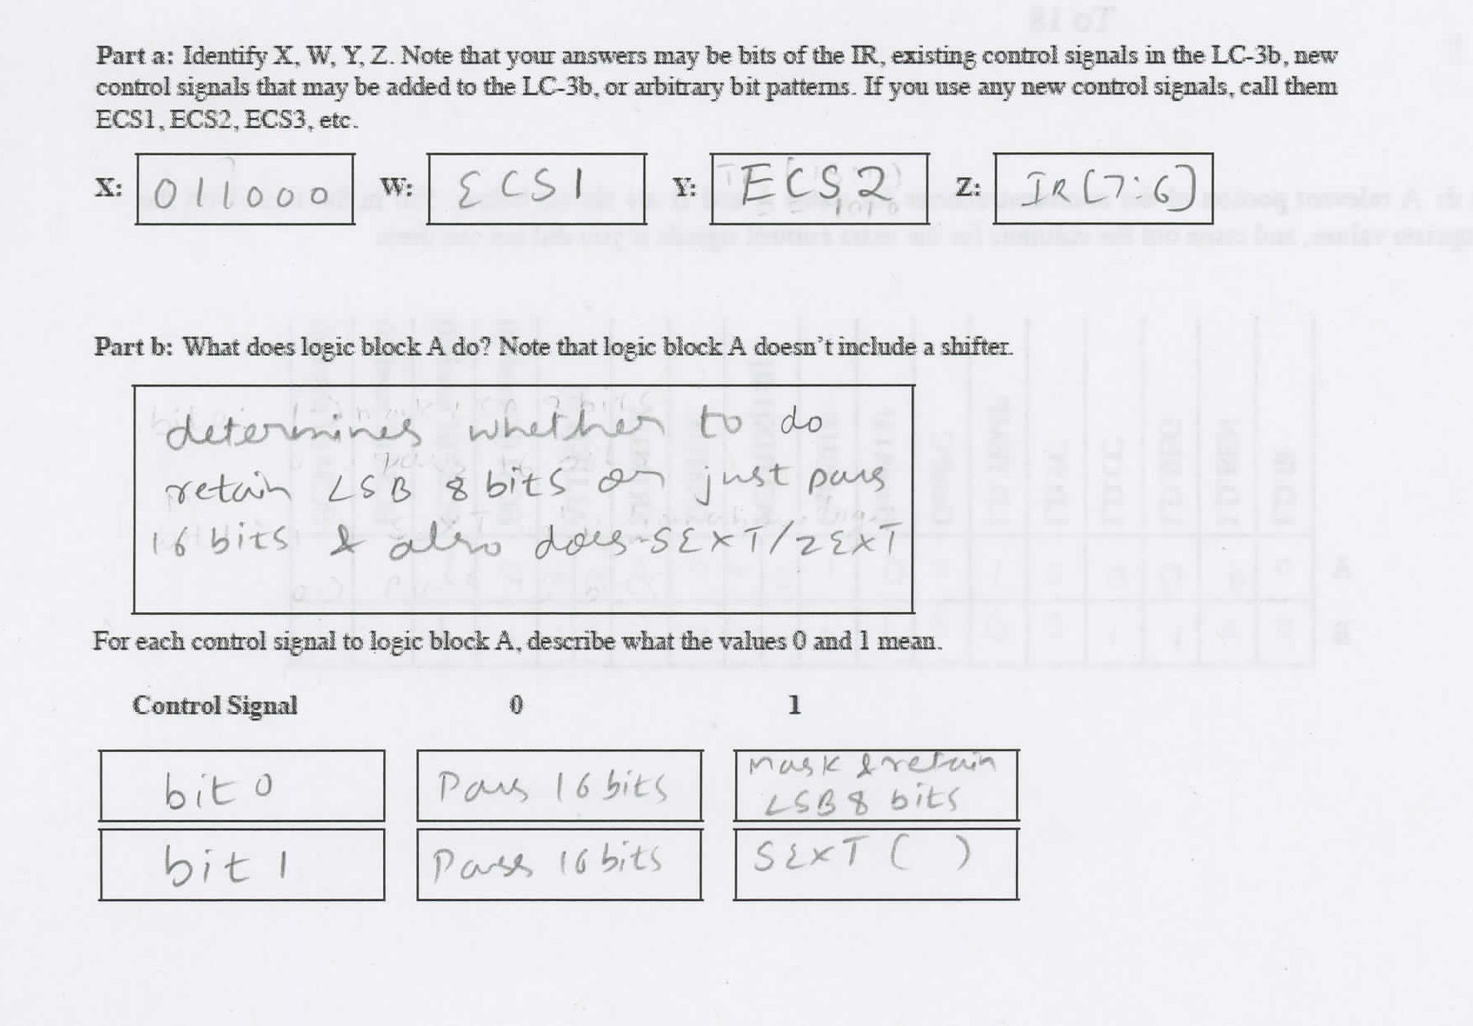
Q8(a,b)

Slide 21
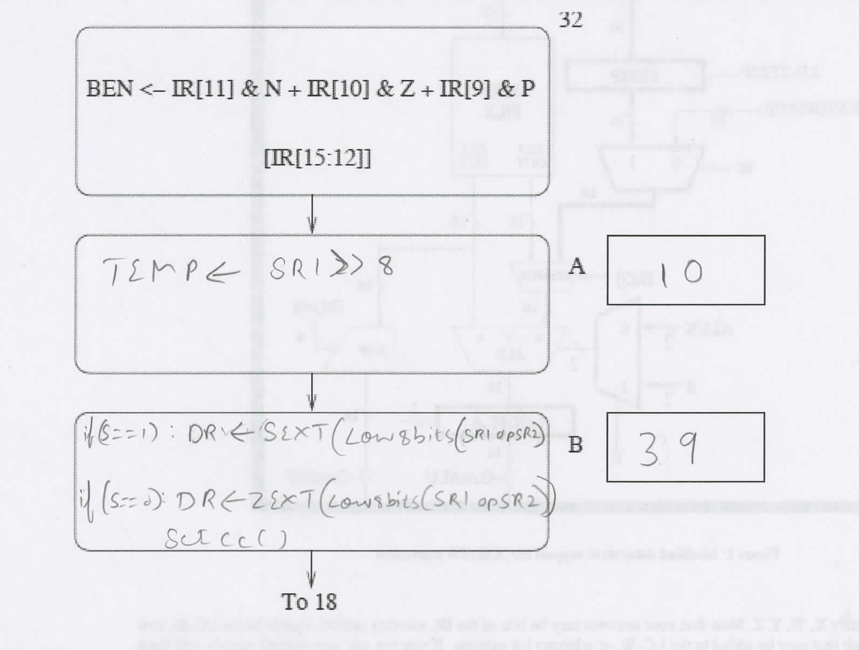
Q8(c)

Slide 22
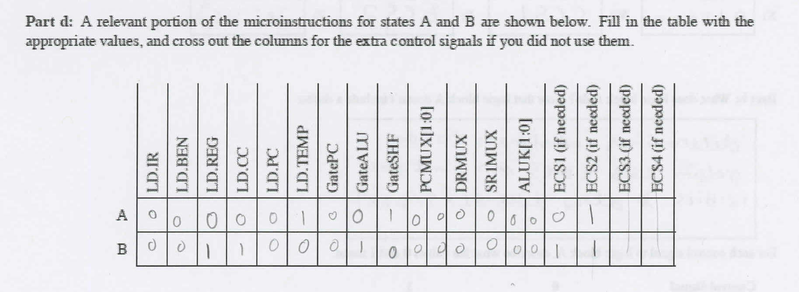
Q8(d)

Slide 23
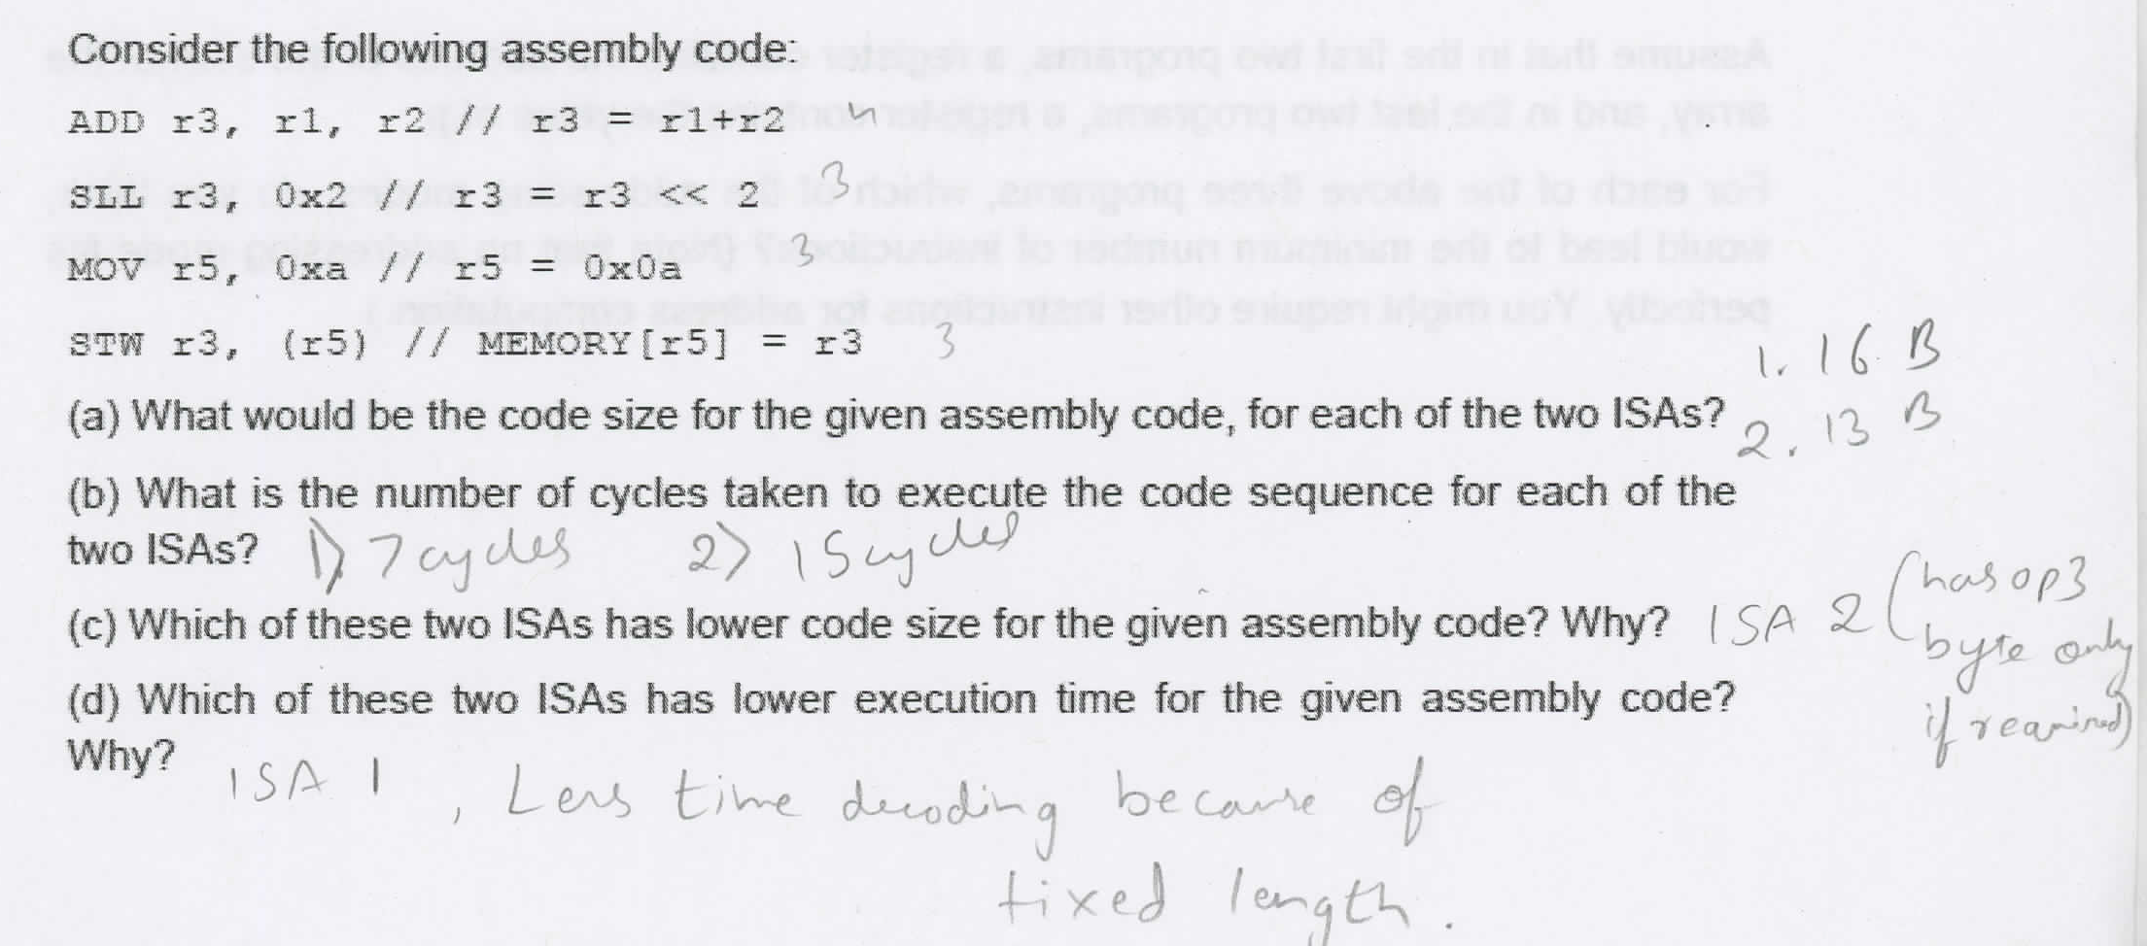
Q9

Slide 24
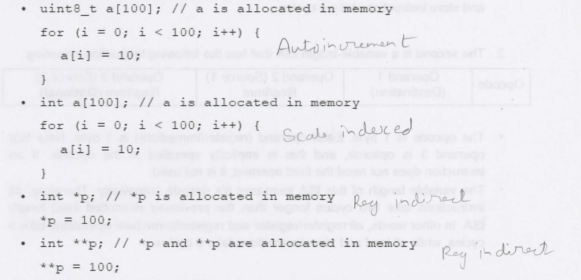
Q10

Slide 25
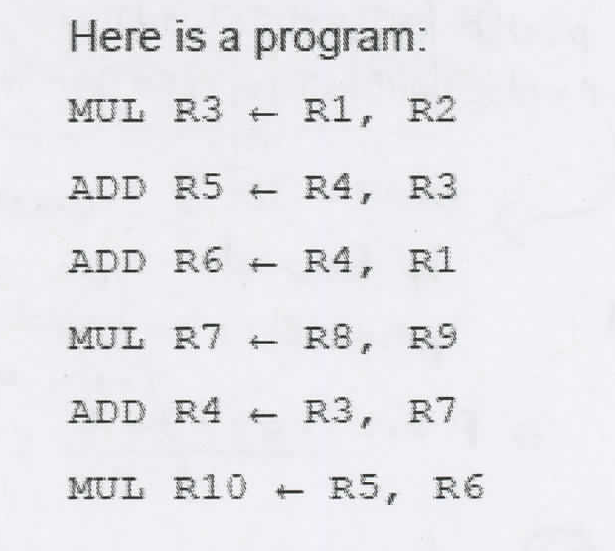
Q11(a) Non Pipeline
Fetch: 1 cycle Decode: 1 cycle
ADD: 2 cycles MUL: 5 cycles
WriteBack: 2 cycles
ADD takes: 1+1+2 (ADD)+2 (WB) = 6 cycles
MUL takes: 1+1+5(MUL)+2(WB)=9 cycles
So, for a pipelined machine, it will be
Total Time = 9+6+6+9+6+9= 45 cycles

Slide 26
Q11(b) Pipeline, No Fwd, 5 ADD, 5 MUL, and Scoreboarding
Fetch: 1 cycle Decode: 1 cycle
ADD: 2 cycles MUL: 5 cycles
WriteBack: 2 cycles
Note:
ADD (inst2) waits for MUL (inst1)
ADD (inst5) waits for MUL(inst1), MUL(inst4)
MUL(inst6) waits for ADD (inst2) and ADD (inst3)
Takes 26 cycles (See Excel Sheet on next page)

Slide 27
Cycle | FETCH | DECODE | E1(ADD) | E2(ADD) | WB1 | WB2
 |  |  | E1(MUL | E2(MUL) | E3(MUL) | E4(MUL) | E5(MUL) | WB1 | WB2
1 | A
2 | B | A
3 | C | B | A(E1)
4 |  |  |  | A(E2)
5 |  |  |  |  | A(E3)
6 |  |  |  |  |  | A(E4)
7 |  |  |  |  |  |  | A(E5)
8 |  |  |  |  |  |  |  | A(WB1)
9 |  |  |  |  |  |  |  |  | A(WB2)
10 | D | C | B(E1)
11 |  | D | C(E1) | B(E2)
12 |  |  | D(E1) | C(E2) | B(WB1)
13 |  |  |  | D(E2) | C(WB1) | B(WB2)
14 |  |  |  |  | D(E3) | C(WB2)
15 |  |  |  |  |  | D(E4)
16 |  |  |  |  |  |  | D(E5)
17 |  |  |  |  |  |  |  | D(WB1)
18 |  | E |  |  |  |  |  |  | D(WB2)
19 |  | F | E(E1)
20 |  |  | F(E1) | E(E2)
21 |  |  |  | F(E2) | E(WB1)
22 |  |  |  |  | F(E3) | E(WB2)
23 |  |  |  |  |  | F(E4)
24 |  |  |  |  |  |  | F(E5)
25 |  |  |  |  |  |  |  | F(WB1)
26 |  |  |  |  |  |  |  |  | F(WB1)

Slide 28
Q11(c) Pipeline, Data Fwd, 5 ADD, 5 MUL
Fetch: 1 cycle Decode: 1 cycle
ADD: 2 cycles MUL: 5 cycles
WriteBack: 2 cycles
Note:
ADD (inst2) waits for MUL (inst1)
ADD (inst5) waits for MUL(inst1), MUL(inst4)
MUL(inst6) waits for ADD (inst2) and ADD (inst3)
Takes 22 cycles (See Excel Sheet for TimeLine)

Slide 29
Cycle | FETCH | DECODE | E1(ADD) | E2(ADD) | WB1 | WB2
 |  |  | E1(MUL | E2(MUL) | E3(MUL) | E4(MUL) | E5(MUL) | WB1 | WB2
1 | A
2 | B | A
3 | C | B | A(E1)
4 |  |  |  | A(E2)
5 |  |  |  |  | A(E3)
6 |  |  |  |  |  | A(E4)
7 |  |  |  |  |  |  | A(E5)
8 | D | C | B(E1) |  |  |  |  | A(WB1)
9 |  | D | C(E1) | B(E2) |  |  |  |  | A(WB2)
10 |  |  | D(E1) | C(E2) | B(WB1)
11 |  |  |  | D(E2) | C(WB1) | B(WB2)
12 |  |  |  |  | D(E3) | C(WB2)
13 |  |  |  |  |  | D(E4)
14 |  | E |  |  |  |  | D(E5)
15 |  | F | E(E1) |  |  |  |  | D(WB1)
16 |  |  | F(E1) | E(E2) |  |  |  |  | D(WB2)
17 |  |  |  | F(E2) | E(WB1)
18 |  |  |  |  | F(E3) | E(WB2)
19 |  |  |  |  |  | F(E4)
20 |  |  |  |  |  |  | F(E5)
21 |  |  |  |  |  |  |  | F(WB1)
22 |  |  |  |  |  |  |  |  | F(WB1)

Slide 30
Q11(d) Pipeline, No Fwd, 1 ADD, 1 MUL, and Scoreboarding
Fetch: 1 cycle Decode: 1 cycle
ADD: 2 cycles MUL: 5 cycles
WriteBack: 2 cycles
Note:
ADD (inst2) waits for MUL (inst1)
ADD (inst5) waits for MUL(inst1), MUL(inst4)
MUL(inst6) waits for ADD (inst2) and ADD (inst3)
Takes 27 cycles (See Excel Sheet on next page)

Slide 31
Cycle | FETCH | DECODE | E1(ADD) | E2(ADD) | WB1 | WB2
 |  |  | E1(MUL | E2(MUL) | E3(MUL) | E4(MUL) | E5(MUL) | WB1 | WB2
1 | A
2 | B | A
3 | C | B | A(E1)
4 |  |  |  | A(E2)
5 |  |  |  |  | A(E3)
6 |  |  |  |  |  | A(E4)
7 |  |  |  |  |  |  | A(E5)
8 |  |  |  |  |  |  |  | A(WB1)
9 |  |  |  |  |  |  |  |  | A(WB2)
10 | D | C | B(E1)
11 |  | C | C WAITS | B(E2)
12 |  | D | C(E1) |  | B(WB1)
13 |  |  | D(E1) | C(E2) |  | B(WB2)
14 |  |  |  | D(E2) | C(WB1)
15 |  |  |  |  | D(E3) | C(WB2)
16 |  |  |  |  |  | D(E4)
17 |  |  |  |  |  |  | D(E5)
18 |  |  |  |  |  |  |  | D(WB1)
19 |  | E |  |  |  |  |  |  | D(WB2)
20 |  | F | E(E1)
21 |  |  | F(E1) | E(E2)
22 |  |  |  | F(E2) | E(WB1)
23 |  |  |  |  | F(E3) | E(WB2)
24 |  |  |  |  |  | F(E4)
25 |  |  |  |  |  |  | F(E5)
26 |  |  |  |  |  |  |  | F(WB1)
27 |  |  |  |  |  |  |  |  | F(WB1)

Slide 32
Q11(e) Pipeline, Data Fwd, 1 ADD, MUL
Fetch: 1 cycle Decode: 1 cycle
ADD: 2 cycles MUL: 5 cycles
WriteBack: 2 cycles
Note:
ADD (inst2) waits for MUL (inst1)
ADD (inst5) waits for MUL(inst1), MUL(inst4)
MUL(inst6) waits for ADD (inst2) and ADD (inst3)
Takes 23 cycles (See Excel Sheet on Next Page)

Slide 33
Cycle | FETCH | DECODE | E1(ADD) | E2(ADD) | WB1 | WB2
 |  |  | E1(MUL | E2(MUL) | E3(MUL) | E4(MUL) | E5(MUL) | WB1 | WB2
1 | A
2 | B | A
3 | C | B | A(E1)
4 |  |  |  | A(E2)
5 |  |  |  |  | A(E3)
6 |  |  |  |  |  | A(E4)
7 |  |  |  |  |  |  | A(E5)
8 | D | C | B(E1) |  |  |  |  | A(WB1)
9 |  | C | C WAITS | B(E2) |  |  |  |  | A(WB2)
10 |  | D | C(E1) |  | B(WB1)
11 |  |  | D(E1) | C(E2) |  | B(WB2)
12 |  |  |  | D(E2) | C(WB1)
13 |  |  |  |  | D(E3) | C(WB2)
14 |  |  |  |  |  | D(E4)
15 |  | E |  |  |  |  | D(E5)
16 |  | F | E(E1) |  |  |  |  | D(WB1)
17 |  |  | F(E1) | E(E2) |  |  |  |  | D(WB2)
18 |  |  |  | F(E2) | E(WB1)
19 |  |  |  |  | F(E3) | E(WB2)
20 |  |  |  |  |  | F(E4)
21 |  |  |  |  |  |  | F(E5)
22 |  |  |  |  |  |  |  | F(WB1)
23 |  |  |  |  |  |  |  |  | F(WB1)

Slide 34
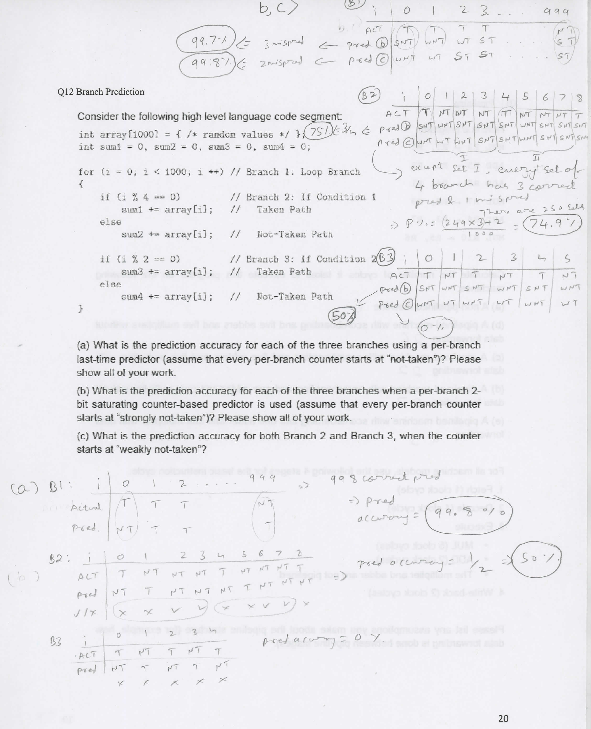
Q12: Two Level Pred (IGNORE FOR MIDTERM 1)

Slide 35
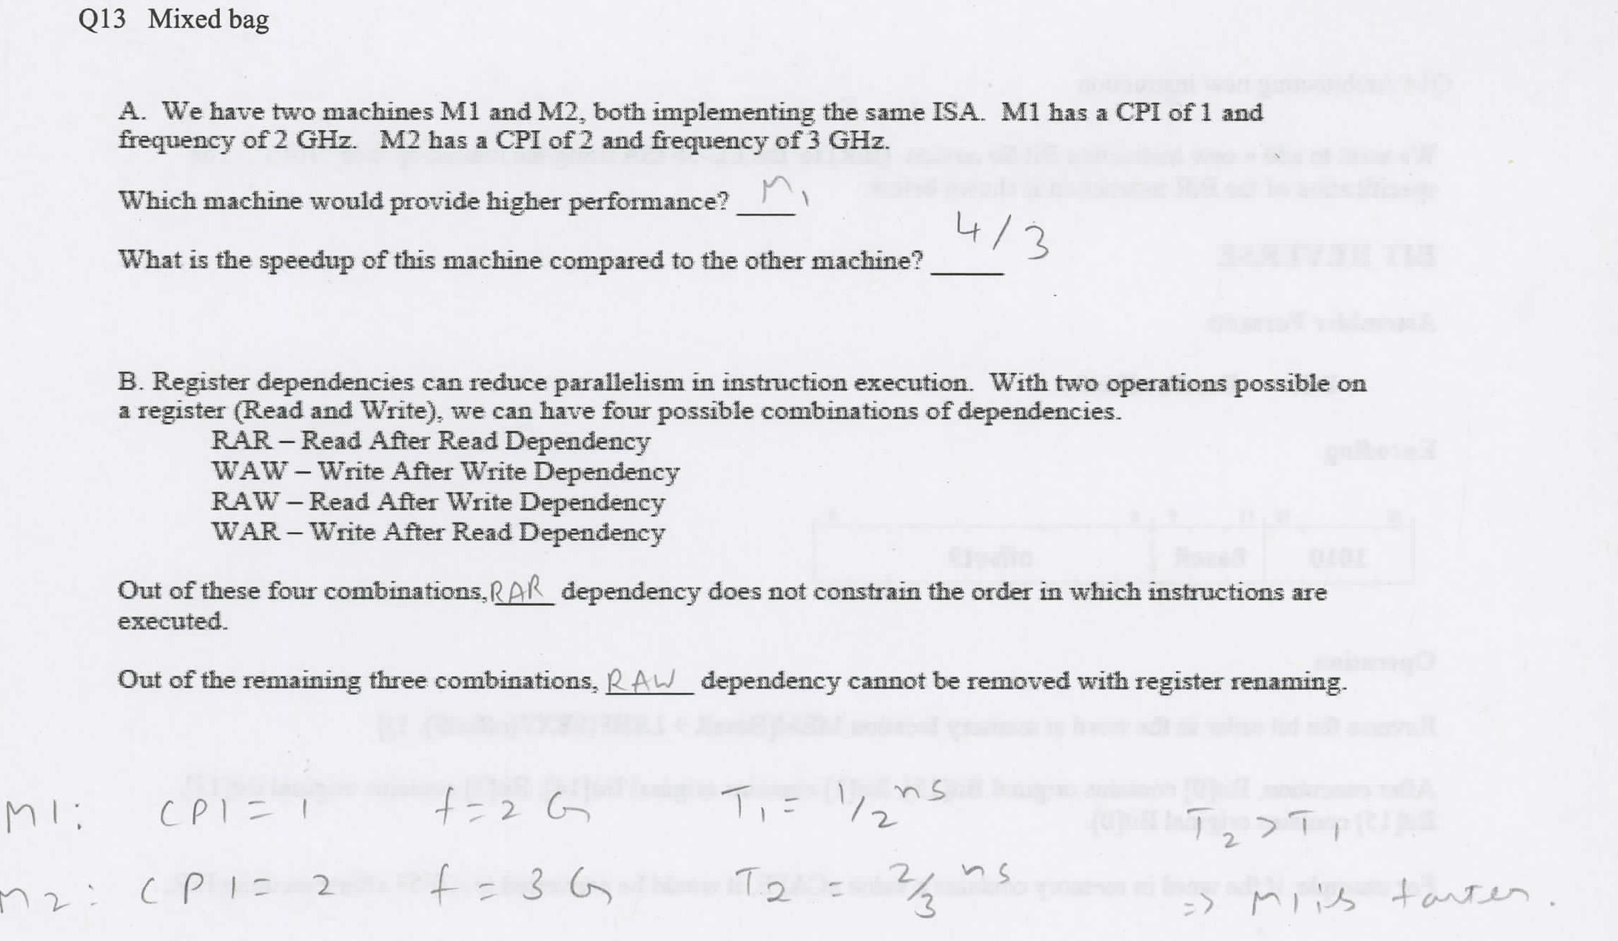
Q13: MIXED BAG

Slide 36
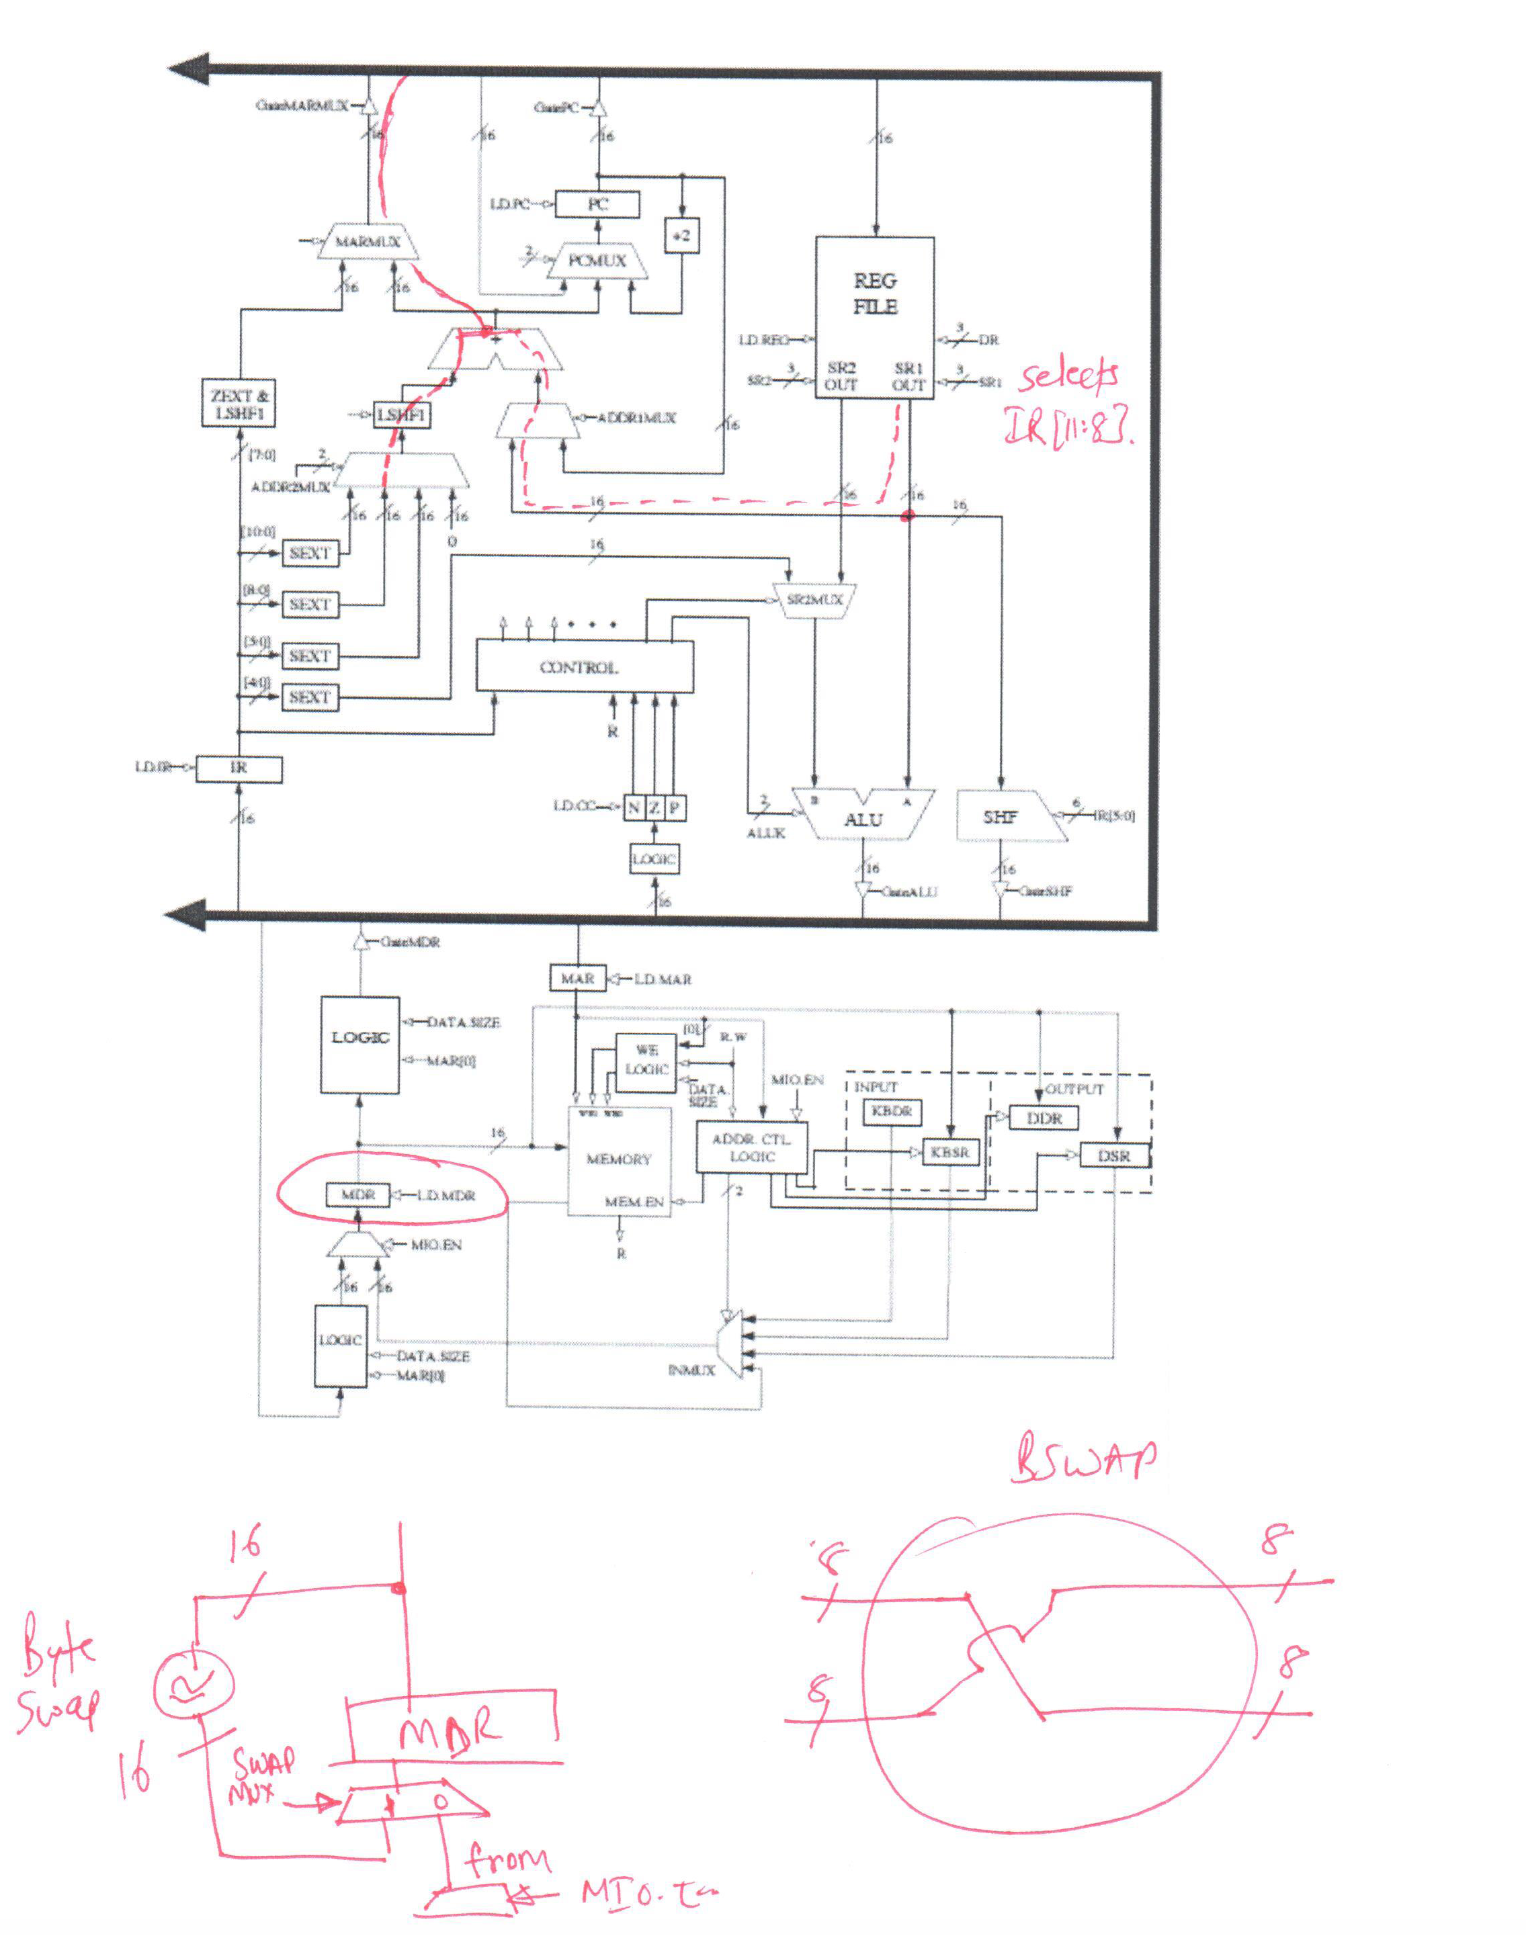
Q14: New Instruction
Note: Bits can be easily reversed
In hardware using shuffling of wires

Slide 37
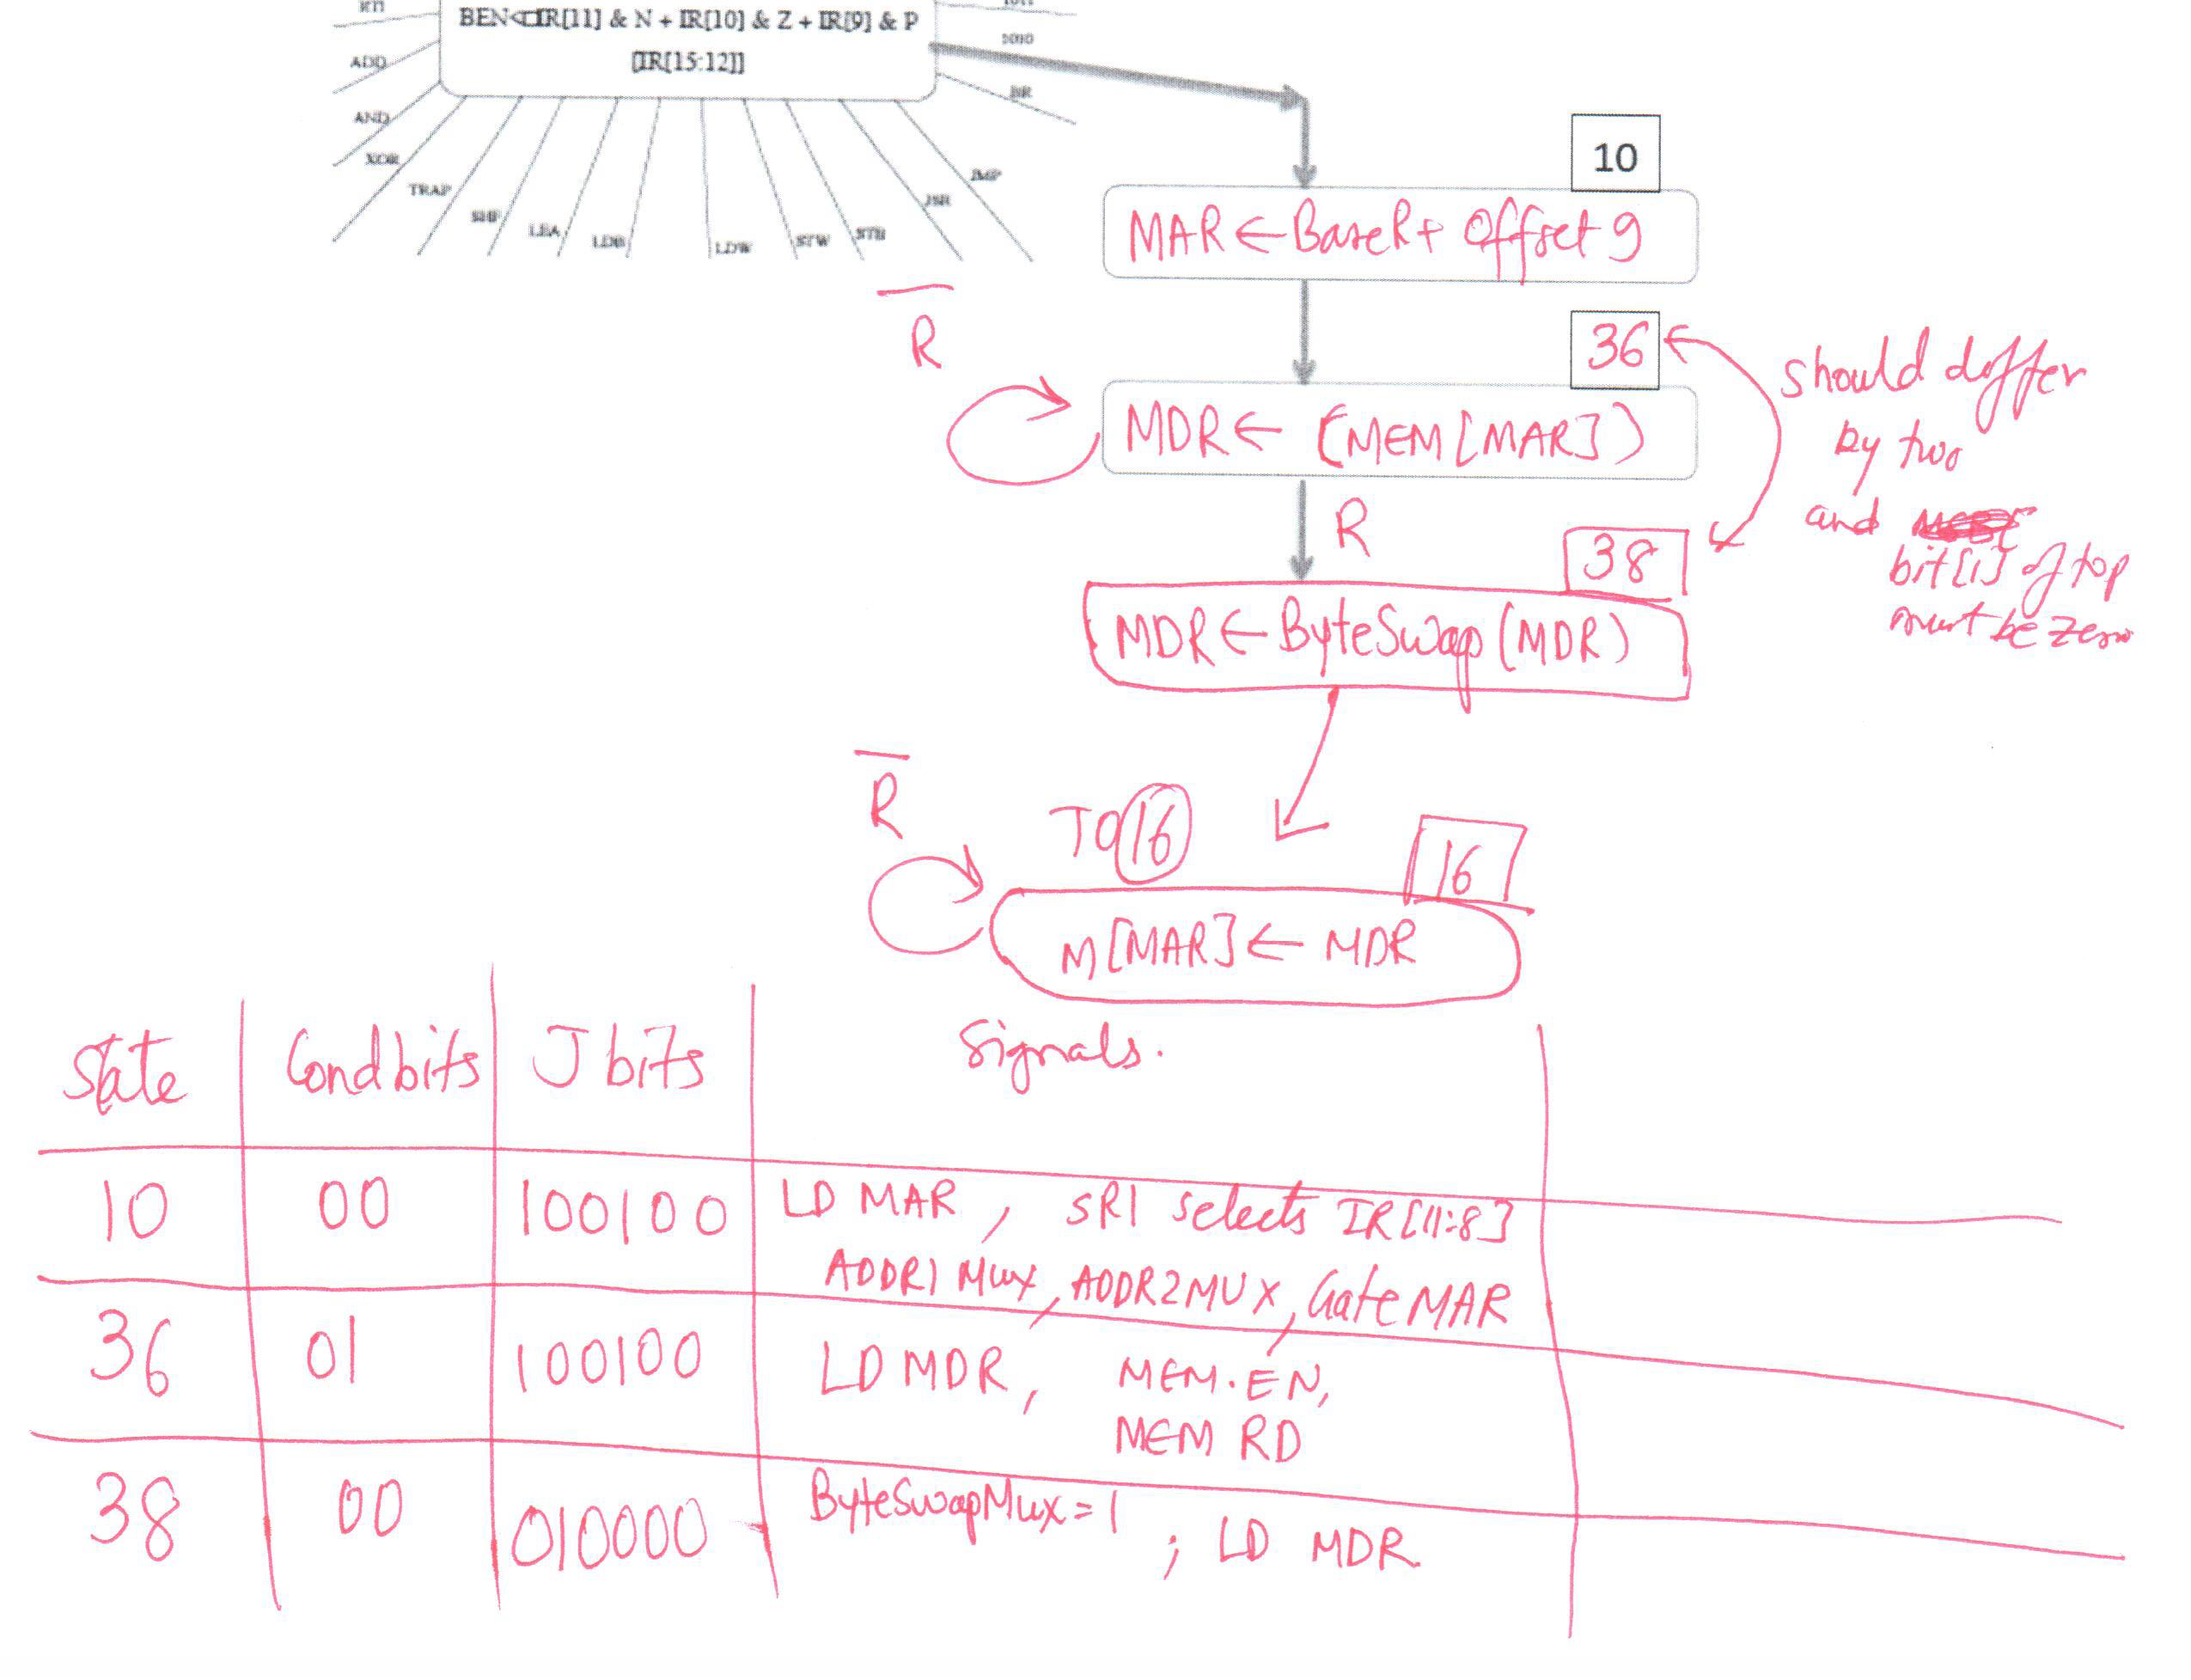
Q14: New Instruction

Slide 38
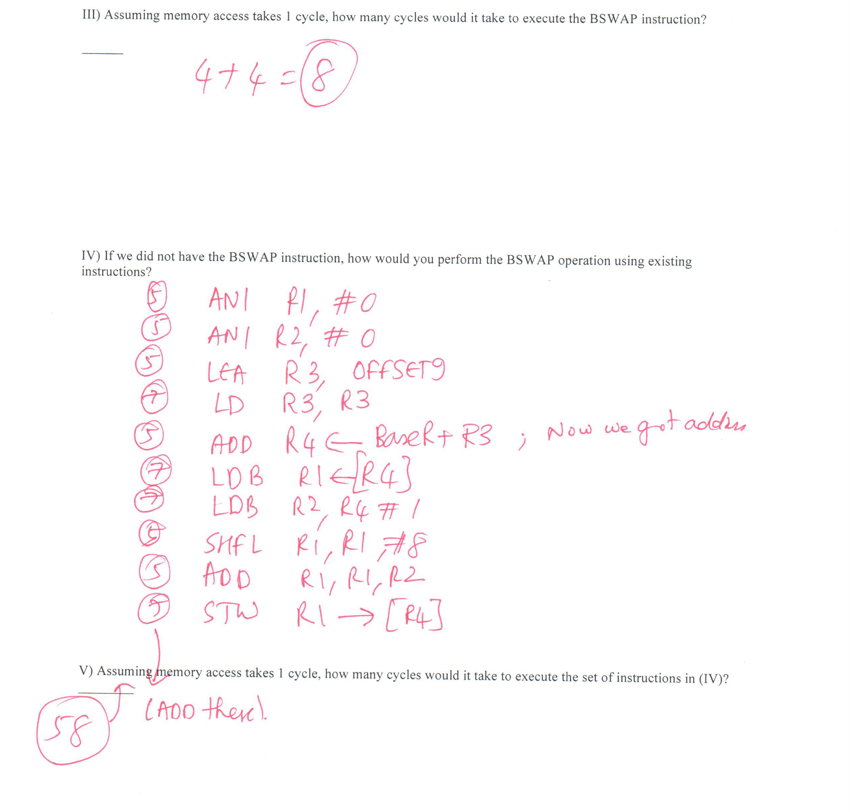
Q14: New Instruction (II, III, IV)

